Slide 1

JavaScript Session 4
25/09/2023
Plan and Homework

Slide 2
Agenda
Learning plan of next weeks
Recap of QuerySelector + click event listener
Developing a basic notes app with JS and Bootstrap5
Github desktop
Homework assignment explanation

Slide 3
Our approach
Learn syntax
Get Certified Online
Do Projects To build portfolio
Interview Preparation
Internship with CodeMentorMU

Slide 4
Projects to-do to build a portfolio
Build with JS
10 basic web-apps
Todo app
Quiz app
Notes app
Quote generator
Age calculator
Weather app
OpenAPI AI draw app
Chrome extension
Build an e-commerce App with React and .Net Core
Build your portfolio website with Three.js and React
Password validator
File uploader
Build Web APIs with .Net Core
10 basic API apps
School App API
More TBC
Task App API
Blog App API
POS App API
Booking App API
Directory App API
Membership App API
Job App API
Notes app API

Slide 5
Session 3 - Recap
document.querySelector("#id");
document.querySelector(".class");
document.querySelector("name");
.addEventListener("click",(e)=>{})

Slide 6
Session 4 - Developing a notes app
Demo

Slide 7
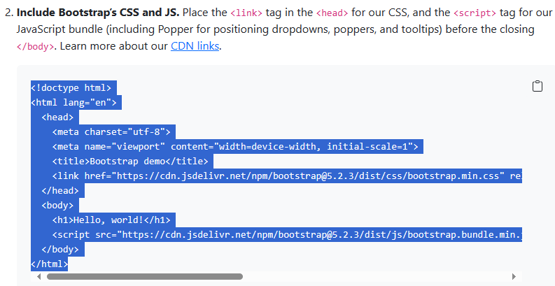
Bootstrap5 Setup
Get started with Bootstrap · Bootstrap v5.2 (getbootstrap.com)

Slide 8
Homework Assignment
JavaScript Certification – To finish in 1 Week
Front End Certification – To finish in 2 Week
Google Analytics Certification
Problem solving for interviews: HackerRank

